Slide 1
Pathogenic bacteria.
Dr.Munira Ch. Ismail
Lec.10,11

Slide 2
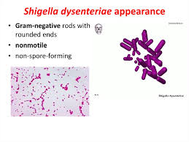
GENUS: SHIGELLA.
Species of medical importance are:
Subgroups
S. dysenteriae A.
S. flexneri B.
S. boydii C.
S. sonnei D.
In developing countries, shigellosis (bacillary dysentery) is caused by S. flexneri and S. dysenteriae.
It is found in human intestinal tract as pathogen

Slide 3
Pathogenesis and Clinical features:
Route of infection is fecal-oral route.
Inoculum dose: 103 organisms.
Pathogenicity determinant:
Toxins:
Endotoxin: irritate the bowel wall.
Exotoxin: Enterotoxin and neurotoxin.
S.dysenritiae type 1(shiga bacillus) produce heat labile exotoxinmediated
diarrhea.
IP: 1-2 days
The Shiga toxins constitute a family of functionally and structurally related toxins produced by Shigella dysenteriae type 1 (also called Shiga’s bacillus) and a subset of diarrheagenic Escherichia coli called STEC (for Shiga toxin-producing E. coli). Shiga toxins of STEC were formerly called Shiga-like toxins and are alternatively named Vero toxins.
It causes shigellosis (bacillary dysentery) characterized by sudden onset of bloody mucoid diarrhea, abdominal cramp, tenesmus, fever, generalized muscle ache and weakness.

Slide 4
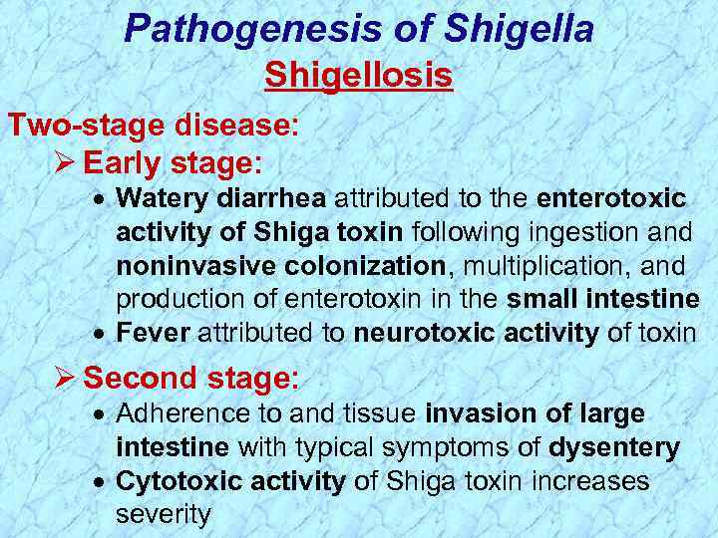
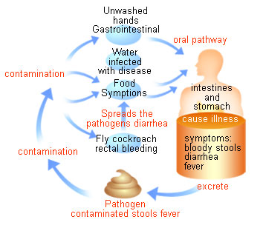
Shigellosis.

Slide 5
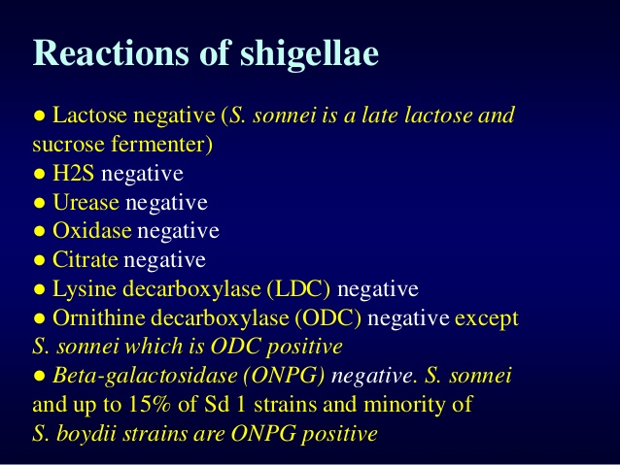
Laboratory diagnosis:
Specimen: Stool,serum
Gram reaction: Gram-negative non-motile rods.
Culture: Non-lactose fermenting colonies on Mac conkey agar and
SS agar.
Biochemical reaction: It produces acid but not gas from carbohydrate.

Slide 6
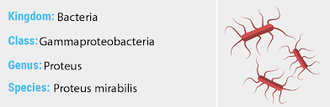
GENUS: PROTEUS.
Proteus species are found in the intestinal tract of humans and animals, soil, sewage and water.
They are gram-negative, motile, non-capsulated , pleomorphic rods. Species of medical importance:
P. mirabilis.
P. vulgaris.

Slide 7
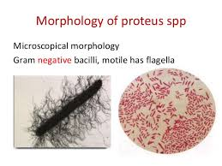
PATHOGENESIS.
Proteus spp. possess several virulence factors that explain their uropathogenic potential, many of which have been investigated in a murine model of UTI (>9). They have pili or fimbriae for adherence to uroepithelium. Additionally, they elaborate cytotoxic hemolysins that lyse red cells and release iron, a bacterial growth factor. Proteus isolates possess flagella for motility. As noted above they produce urease, leading to the formation of struvite stones.

Slide 8
Clinical features:
P. mirabilis.
. Urinary tract infection.
. Septicemia.
. Abdominal and wound infection.
. Secondary invader of ulcer, burn, pressure sores and chronic discharging ear.
P. vulgaris.
. Important nosocomial pathogen.
.Isolated in wound infection and urinary tract infection.
Laboratory diagnosis:
Specimen: Urine, pus, blood, ear discharge.
Smear: Gram-negative rods.
Culture: Produce characteristic swarming growth over the
surface of blood agar.
Ditching of culture media prevents spread of proteus species.
Non-lactose fermenting colonies in mac conkey agar.
Proteus species have a characteristic smell.
Biochemical reaction:
Proteus spp……….. Urease positive
P. vulgaris………... Indole positive
P. mirabilis……….. Indole negative

Slide 9
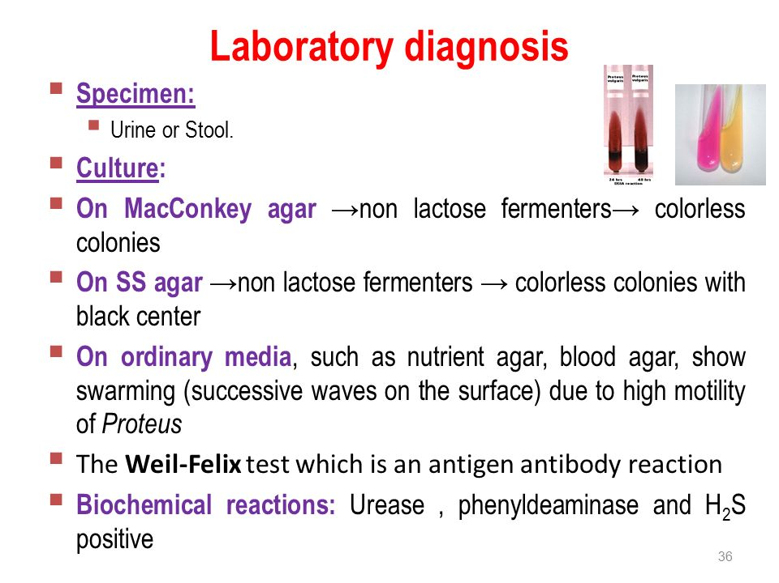
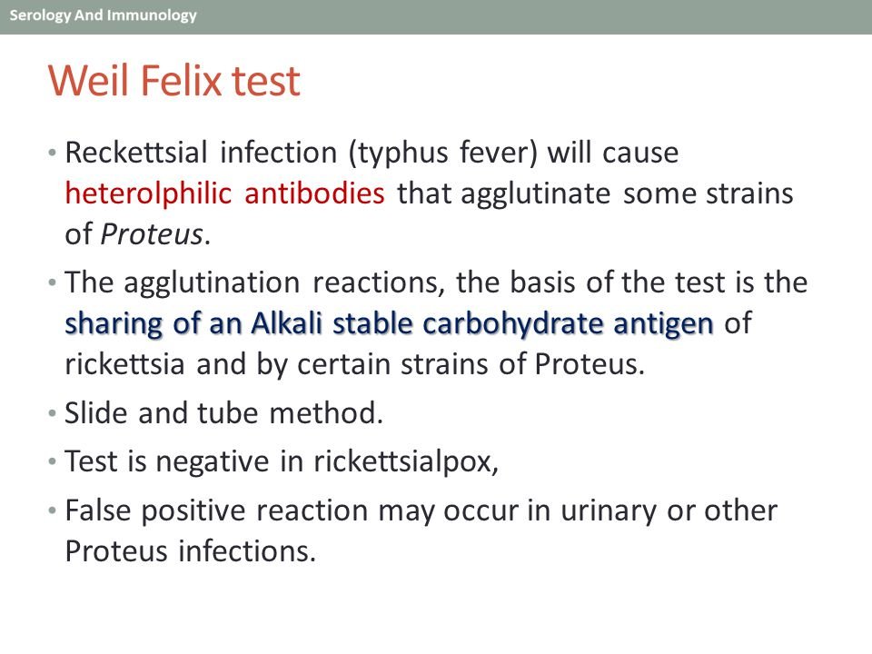

Slide 10
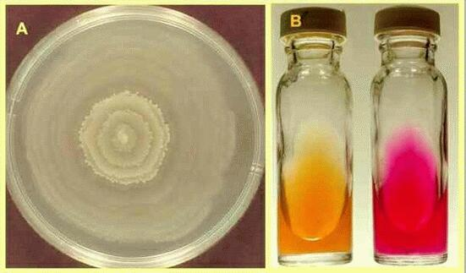
A-Swarming test. B-Urease test.

Slide 11
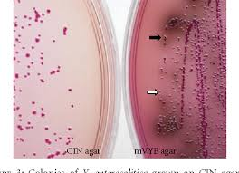
GENUS YERSINIA.
General characteristics:
• Animals are natural hosts of yersinia, and humans are accidental hosts of yersinia infection.
• Short, pleomorphic microaerophilic or facultatively anaerobic gram negative rods exhibiting bipolar staining with special stains.
Yersinia.on MacConkey agar.

Slide 12
Important human pathogens:
Y. pestis.
Y. pseudotuberculosis.
Y. enterocolitica.
Yersinia pestis.
. Plague bacillus with gram negative, non-motile, facutatively anaerobe possessing bipolar granules.
Pathogenesis and clinical features:
Rat flea (Xenopsylla cheopis) gets infected by biting an infected rodent → infected rat flea bites human (accidental host) → organism migrate to regional lymphnodes from the site of bite (bubonic plaque) and gets into the blood via lymphatics (septicemic plaque), or Primary pneumonic
plaque results from inhalation of infective droplets, usually from an
infected coughing person.
IP=2-6 days

Slide 13
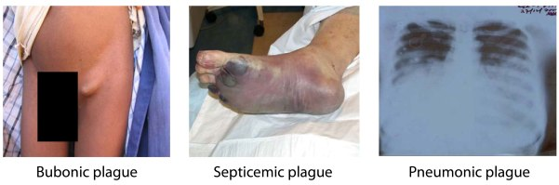
Human Plaque: 3 types.
1. Bubonic plague: Fever, vomiting, painful lymphadenitis(buboes) in the groin or axillae.
2. Pneumonic plague: Ip is 1-3 days.
Profuse mucoid or bloody expectoration with signs of pneumonia.
3. Septicemic plague.
Fever, vomiting, diarrhea, hypotension, altered mentation, renal and heart failure, intra vascular coagulopathy.
Human plaque types.

Slide 14
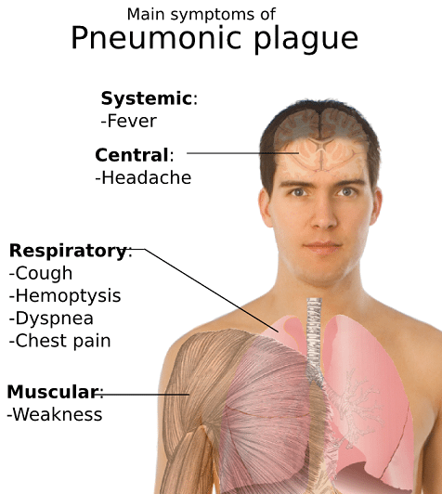

Slide 15
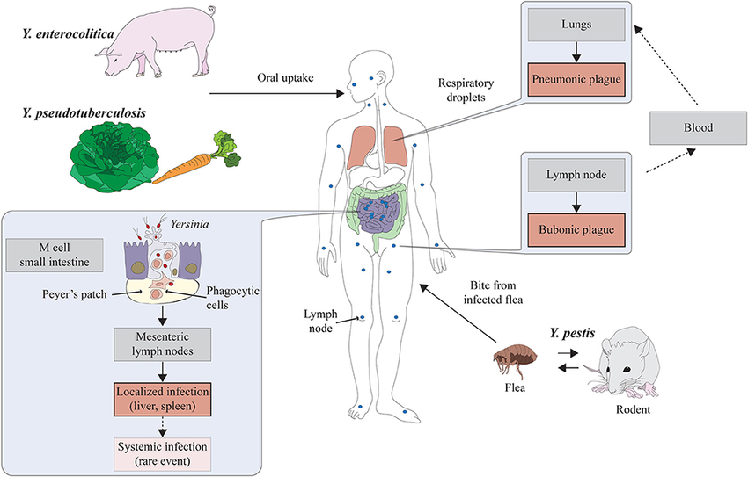
Yersinia pathogenesis.

Slide 16
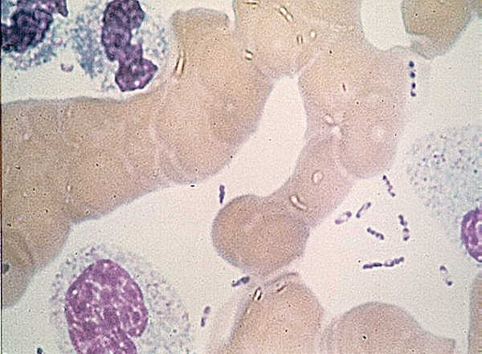
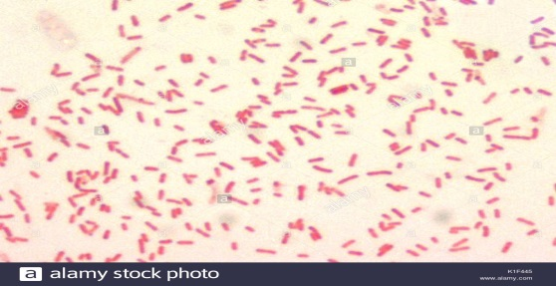
Lab. Diagnosis:
Specimen: Lymphnode aspirate, CSF, blood.
Smears: Wright’s stain, immunofluorescence stain, methylene blue stains, basic fuchsin stain.
Wayson’s stain to demonstrate bipolar granules.
Cuture: Grow in blood agar or mac conkey agar.
NB: All cultures are highly infectious and must be handled with extreme caution.
Wayson’s stain.
Gram stain.

Slide 17
Biochemical reaction:
Catalase positive.
Oxidase negative.
Serology: Fluorescent antibody technique using Y. pestis antisera.
Prognosis: Mortaity rate is 50% (100% for pneumonic plaque).
Yersinia enterocolitica and Yersinia pseudotuberculosis.
Non-lactose fermenting gram negative rods.
Urease positive.
Oxidase negative.
Y. enterocolitica. > 50 serotypes.
. Y. enterocolitica Serotype 03, 08, and 09 cause human disease.
. Human infection occurs by contaminated food and drinks from domestic animals or rodents.
Y. pseudotuberculosis.
. Six serotypes.
. Y. pseudotuberculosis serotype 01 accounts for most human infection.
. Human infection results from ingestion of food and drinks contaminated by animalfeces.

Slide 18
Pathogenesis and clinical feature:
Route of transmission: Contaminated food and drinks
Inoculum dose: 108-109 org
IP=5-10 days
Yersinosis: Enterocolitis.
. Fever, abdominal pain, toxin and invasion-mediated diarrhea.
. Usually self-limited disease.
. Post-diarrheal diseases.
. Arthritis.
. skin rash/nodules.
Lab. Diagnosis:
Specimen: Stool, blood, rectal swab.
Culture: Grow in routine enteric media.
Biochemical tests for species identification.

Slide 19
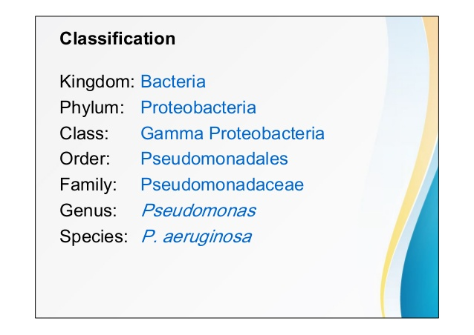
GENUS: PSEUDOMONAS.
General characteristics:
. Gram-negative motile aerobic rods having very simple growth
requirement.
. Can be found in water, soil, sewage, vegetation, human and animal
intestine.

Slide 20
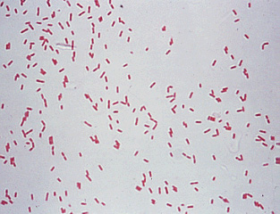
.
Species of medical importance:
P. aeruginosa.
Pseudomonas aeruginosa.
. Found in human and animal intestine, water, soil and moist environment
in hospitals.
. Primarily a nosocomial pathogen.
. Invasive and toxigenic, produces infections in patients with abnormal host defenses

Slide 21
Clinical features:
Pathogenic only when introduced into areas devoid of normal defenses eg. Breached mucus membrane or skin, use of IV line or urinary catheterization, neutropenia of any cause.
. Urinary tract infection- chronic, complicated Urinary tract infection and associated with indwelling catheter.
. Wound infection of burn sites, pressure sores and ulcers.
.Septicaemia- “Ecthyma gangrenosum” skin lesion (haemorrhagic skin necrosis).
. Otitis externa- Malignant external ear infection in poorly treated diabetic patients.

Slide 22
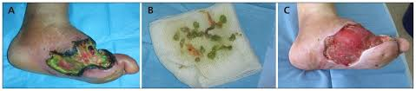
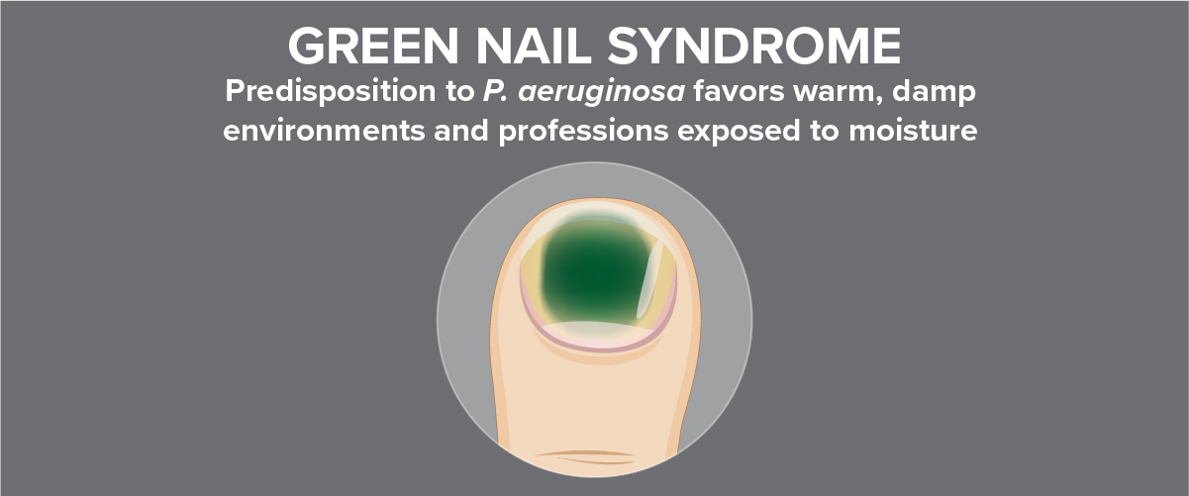
wound and burn infection.

Slide 23
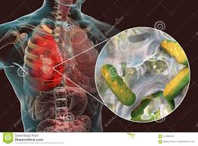
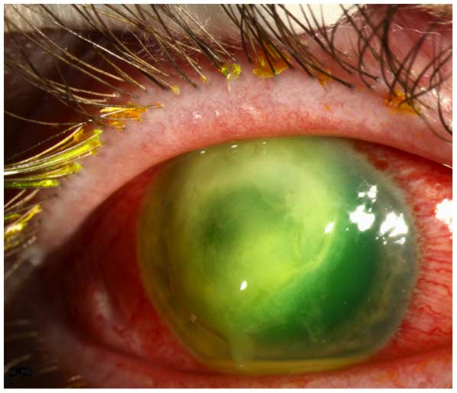
Pneumonia- Infection of the lung in patients with cystic fibrosis.
. Eye infection- Secondary to trauma or surgery.
Pneumonia.
Eye infection.
Laboratory diagnosis:
Specimen: pus, urine, sputum, blood, eye swabs, surface swabs.
Smear: Gram-negative rods.

Slide 24
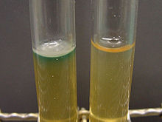
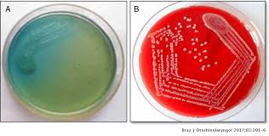
Culture:
.Obligate aerobe, grows readily on all routine media over wide range of temperature(5-42 OC).
. Bluish-green pigmented large colonies with characteristic “fruity” odor on culture media.
Growth of P.aeruginosa on culture media.
. Biochemical reaction:
. Oxidase positive
. Catalase positive
. Citrate positive
. Indole negative
. Produce acid from carbohydrate by oxidation, not by fermentation.

Slide 25
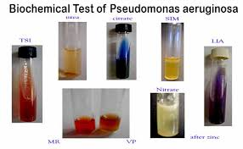
NB: identification of the bacteria is based on colony morphology,oxidase-positivity, characteristic pigment production and groth at 42°c.

Slide 26
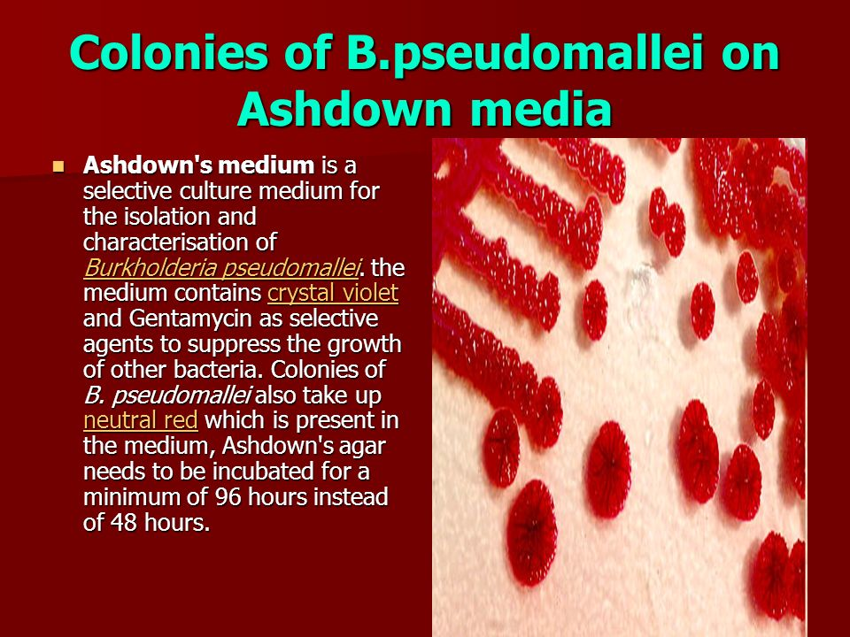

Slide 27


